Slide 1

Eff {Strings} Last.fm Music Data Study
Amber
Christian
Ishmael
Steve

Slide 2
Background
Last.fm is a global application that builds a profile of users’ musical taste based on the
songs a user listens to on internet radio, their PC, or other portable music devices.
They pay unsigned artists royalties to stream their music.
Last.fm CEO has tasked music supervisors with recommending and selecting appropriate
music and licenses to provide on their app.
Music Supervisors are analyzing global music data against Gross National Product (GNP)
To determine whether economic indicators affect listeners and play counts. This
information will inform the most profitable music selections globally, providing guidance
to inform Music Supervisors’ selection criteria.
Amber
Christian
Ishmael
Steve

Slide 3
Hypothesis
If GDP is lower, Last.fm will have a higher listenership.

Slide 4
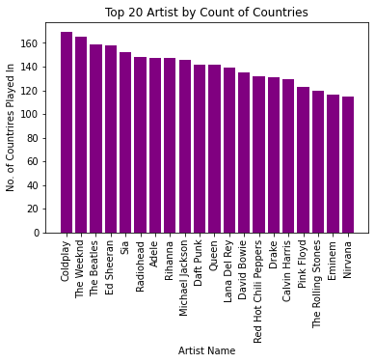
Which artist are most popular based on their country play count?
Data demonstrates that:
Coldplay
The Weekend
The Beatles
Ed Sheeran
Sia
Radiohead
Adele
are among the artists most played in the countries streaming music the most often.
Music quote here

Slide 5
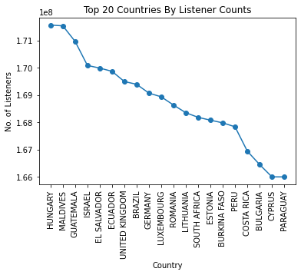
Which countries’ users engage the most with the app?
Hungary has the most users engaged with the app, followed closely with Maldives.
Followed by
Guatemala
Israel
El Salvador
Ecuador
United Kingdom
Music quote here

Slide 6
Who are the top artists by listener count in the country with the highest overall listener count (Hungary)?
Ishmael
Music quote here

Slide 7
Who are the most popular artists by listeners per country? Christian
Music quote here

Slide 8
Which 5 artists are played most often globally? Amber
Music quote here

Slide 9
What are the most popular genres by listener per country? Steve/Christian Geomap
Music quote here

Slide 10
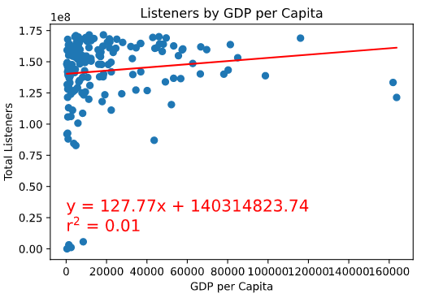
What is the GDP and play count of each country? Steve/Christian Statistical analysis
I think this should go first, as it would give context to the rest of the data given our hypothesis.
How can we explain the caveat of listener vs playcount?
Music quote here

Slide 11
Task breakdown
All members
Read and adhere to requirements.
Contribute to presentation
Ishmael
Graph types 7 and 8
Steve
Repo management
Graph types 3 and 4
Amber
Organize approach
Graph Top 5 artists globally
Christian
Graph types 5 and 6

